Slide 1


Shield Insurance Project
PRESENTED By – Aashutosh Marathe
Data Analyst Intern at AtliQ Mart presented in code basics virtual Internship

Slide 2
Key Metrics
Total Revenue - Total Revenue for Selection
Total Customers - Total Customers for a given selection
DRG - Daily Revenue Growth
DCG - Daily Customer Growth
Change% - Month over Month Change %

Slide 3
Sales Mode
Online Mode - Application and Website
Offline Mode – Agent and Direct

Slide 4
Data Sets
Dim_customer
Dim_date
Dim_policies
Fact_premiums
Fact_settlements

Slide 5
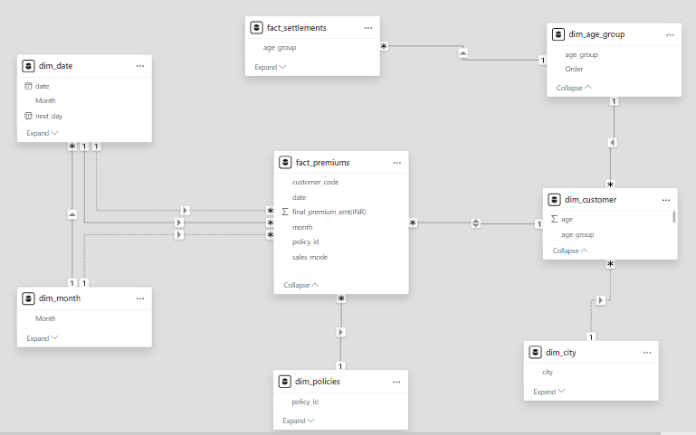
Data Model

Slide 6

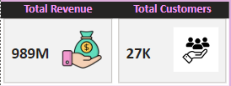
KPI Indicators
Total Customers are 3787 and increasing
Daily customer Growth is by 126
Daily Revenue Growth is by 4.39 Million
Total Revenue is 131.69 Million
Total Revenue overall is 989 Million
Total Customers overall are 27 thousand

Slide 7
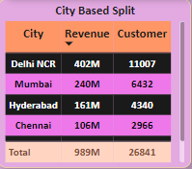
Key Insights
Delhi NCR- Shield Insurance dominates with the largest customer base and revenue, demonstrating a robust market presence.
Mumbai – Boasts a solid customer base, contributing significantly to revenue, indicating promising market potential.
Hyderabad and Chennai – Despite smaller customer numbers, they are crucial in driving overall revenue, showcasing strategic importance

Slide 8
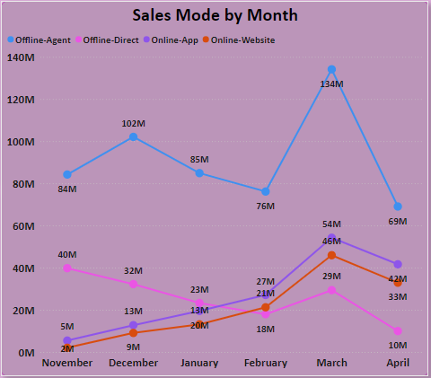
Sales by Sales Mode
Offline-Agent highest sales were made in the month of March.
Offline-Direct highest sales were made in the month of November.
Online-App highest sales were made in the month of March.
Online-Website highest sales were made in the month of March.

Slide 9
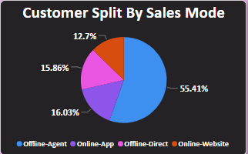
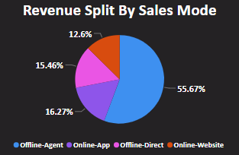
Maximum revenue coming from offline agents.
Only the Website is giving the least revenue overall.
More incentives given to agents can increase revenue drastically.
Need to work on the Website to attract more customers here more advertising can help to bring customers to the landing page.

Slide 10
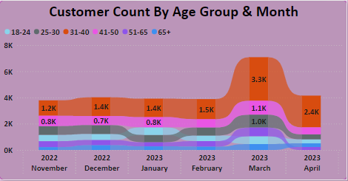
Key Insights from Age group
The number of more customers are engaged from the age group 31-40 at its peak in the month of March.
The age group 18-24 was at its peak in the month of January.
The age group 25-30 was at its peak in the month of March
The age group 41-50 was at its peak in the month of March.
The age groups 51-65 and 65+ were at their peak in March and remained constant respectively.

Slide 11
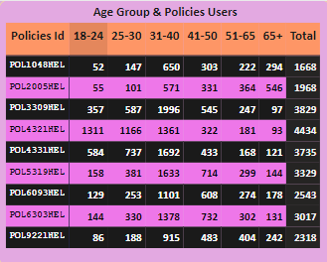
Key Insights by Age Group and Policies Users
Policy Distribution Insights:- Policy ‘POL4321HEL’ commands a substantial customer base of 4,434, while ‘POL2005HEL’ emerges as the top revenue-generating policy, underscoring its efficacy in driving financial performance for Shield Insurance.

Slide 12
Thank You!!

